Slide 1

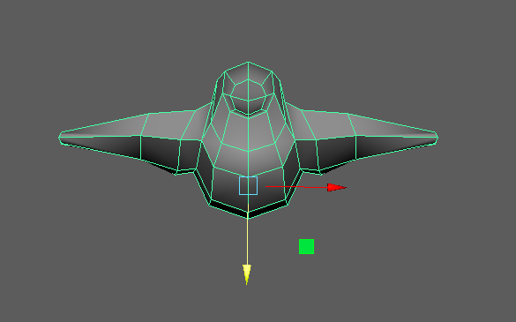
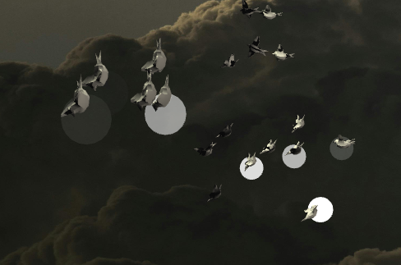
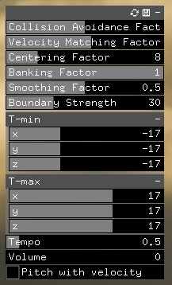
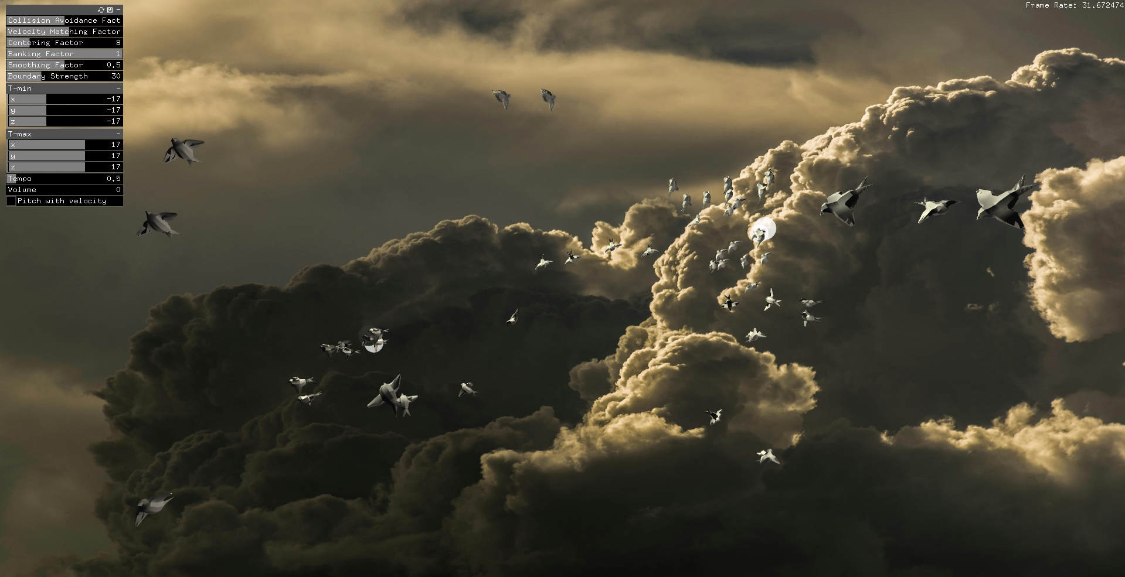
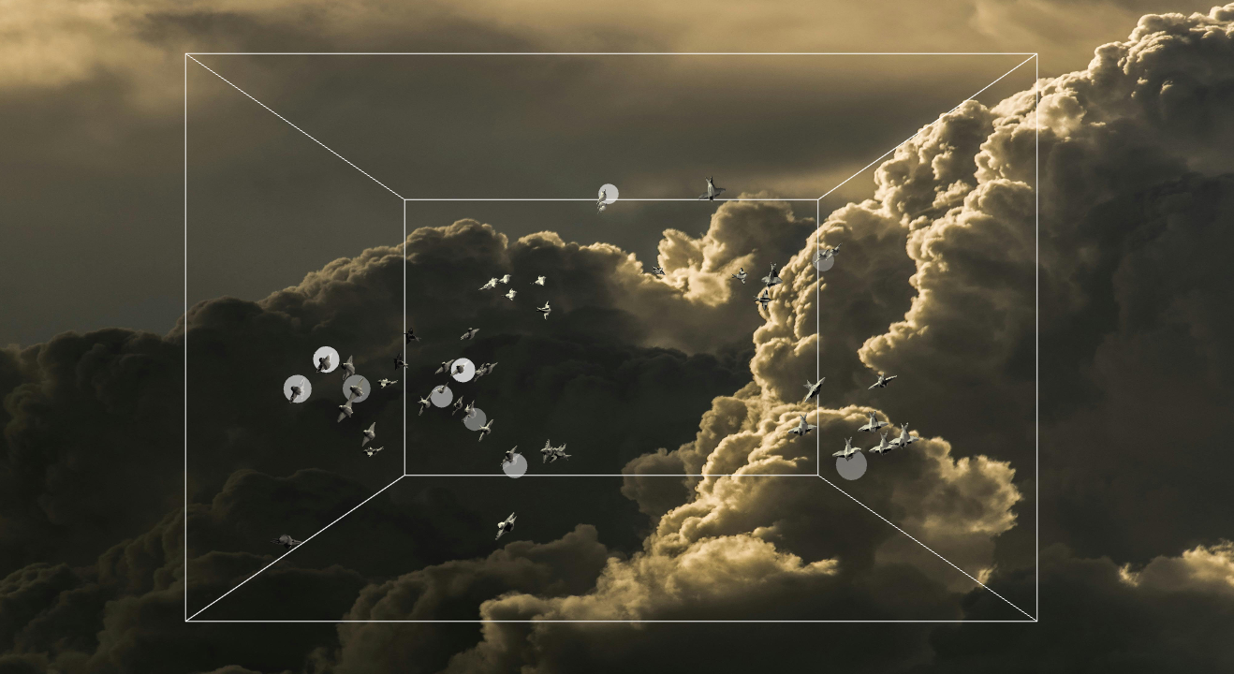
Computer Science Department
Final Project: Boid Orchestra
Course Instructor: Kevin Smith
Victoria Vo
Introduction
Methodology
The instrument was determined by the boid’s altitude. If the boid was in the upper third of the bounding box, a kalimba note was played. If they were in the middle third, a piano note was played. Finally, if they were in the lower third, a guitar note would play.
The tempo was influenced by the number of neighbors surrounding the boid. Each boid is generated with a random base tempo. This tempo increases as other boids come within a certain distance to the boid, and decreases as they leave. In this way, clusters within the flock tend to play sounds in a similar tempo.
Lastly, the pitch was adjusted according to the boid’s speed. The faster a boid was travelling, the higher its pitch became. This was done using ofSound’s setSpeed() function. By increasing the speed of a sound, its pitch becomes higher.
The flocking simulation algorithm was developed by Craig W. Reynolds in 1986 to simulate flocking behavior through physically-based animation [1]. The algorithm computes acceleration forces for collision avoidance, velocity matching, and centering, and applies these forces to artificial life models called boids to achieve life-like flocking behaviors similar to those found in birds flying through the sky, schools of fish swimming underwater, and crowds of humans making their way around each other.
My project aims to combine Reynold’s flocking simulation algorithm with sonification to create a procedurally-generated musical orchestra influenced by the flock members’ movements. This project takes great inspiration from the very similar Flocking Orchestra art installation created by Tatsuo Unemi and Daniel Bisig in 2004 [2], which uses the viewer’s movements to influence the boids’ movements and sound generation.
With each sound that is made, a white circle is drawn to indicate the boid that it came from. Additionally, background music is constantly being played to bring the sound design all together.
Developing The Flocking System
Using Reynolds’ algorithm and code implementation examples from the course textbook [3], I added multiple functionalities to the simulation. Firstly, collision avoidance, velocity matching, and centering made up the foundation of flocking forces acting on the boids. Acceleration prioritization was applied to these forces using a max acceleration, distance thresholds, and a field of view. Banking angle was computed to determine how far a boid should rotate along its local x-axis during a turn.
The most challenging implementation was boundary collision avoidance. The flock is encapsulated by a bounding box whose walls emit a repellent force when the boids get too close. Calculating this force stumped me, so I turned to the Flocking Orchestra’s source code and reworked Unemi and Bisig’s solution to fit my needs.
In the event that the boundary force fails to contain a boid, a wrapping feature was implemented as a failsafe. This wraps the boid back around to the opposite wall when they escape a boundary wall.
Methodology
Analysis and Results
Summary/Conclusions
OpenFrameworks
Openframeworks, an open source C++ toolkit, was used to develop this project for convenience. It provides many modules useful for creative coding, including ofxGui for creating a GUI panel, ofSound for incorporating sound in the project, and ofxAssimpModelLoader for drawing 3D models.
The Flocking Simulation
The resulting application seen by the viewer is shown below. In the center, the flocking simulation is played with fifty boids. Viewers can adjust flocking behavior parameters in real-time using the GUI panel. This includes changing the collision avoidance, velocity matching, and centering scalers, banking and smoothing factors, and turbulence force ranges. In the lower left corner, the frame rate is printed.
The resulting application is a visually appealing flocking simulation accompanied by an orchestral experience. Customization features allow viewers to create a unique experience catered to their preferences.
Future works and improvements can include improved sound design to create more harmonious orchestral music. Additionally, audio input can be implemented so that, instead of the boids’ movements influencing the music, music input can influence the boids’ movements.
Key References
[1] C. W. Reynolds. “Flocks, Herds, and Schools: A Distributed Behavior Model.” in ACM SIGGRAPH Computer Graphics, vol. 21, no. 4, pp. 25-34, 1987.
[2] T. Unemi and D. Bisig. “Playing Music by Conducting BOID Agents – a Style of Interaction in the Life with A-Life.” in Proceedings of the Ninth International Conference on the Simulation and Synthesis of Living Systems, pp. 546-550, 2004.
[3] D. H. House and J. C. Keyser. “Flocking Systems” in Foundation of Physically Based Modeling and Animation. CRC Press, 2017, pp. 133-142. [Online]. Available: https://repository.gctu.edu.gh/items/show/1203
The Procedural Orchestra
The GUI panel includes a slider that controls the boids’ baseline tempos. Increasing the slider will increase the rate of sounds being played, while decreasing it will cause the sounds to be more spaced apart.
There is also a toggle for turning on and off pitch adjustment with velocity. When this is turned on, the pitch of the sounds will be determined by the speed of the boid. The faster the boid travels, the higher its pitch will be.
Maya
Maya, a 3D computer animation and modeling software, was used to create low-poly animated bird models to be used as sprites for our simulation’s boids.
Acknowledgements
Developing the Sound System
The orchestra’s sound design was made up of three main components: instrument, tempo, and pitch.
The project could not be accomplished without the support and guidance of my Computer Graphics instructor, Professor Kevin Smith.

